Slide 1
Gene selection and classification
of microarray data
Neural network and AdaBoost
BMES 543
Anna Lu
Yang Wan

Slide 2
Introduction

Slide 3
Intro Problem
Gene classification common for expression studies
Ranking genes applies only to two class data
Need other classification methods for multiclass data
Classifiers used for microarray data and gene selection
Standard | Proposed in Literature | This Project
Ranking genes K Nearest Neighbors Support Vector Machine | Random Forest Bayesian | AdaBoost Neural Network
Notes:
1

Slide 4
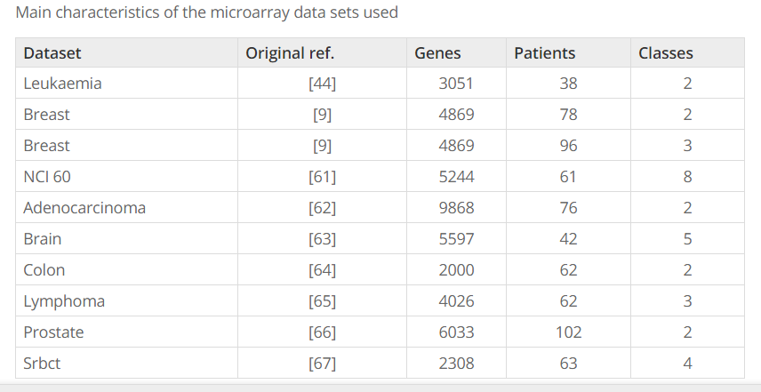
NCI 60 = Human Tumor Cell Lines
Notes:
NCI 60 https://dtp.cancer.gov/discovery_development/nci-60/

Slide 5

Intro Microarray Data: Leukemia example
Class (0 or 1) with columns as targets (response)
Microarray samples with rows as features (predictors)
Notes:
3

Slide 6
Goals & Experiment

Slide 7
Intro Goals
Apply classification methods Neural Network and AdaBoost for microarray data
Evaluate Neural Network and AdaBoost performance for classification of microarray data
Notes:
2

Slide 8
Experiment
Apply machine learning models to Microarray Classification
AdaBoost
Neural Network
Assess model performance by comparing error rates
Notes:
3

Slide 9
Method 1
Neural Network

Slide 10
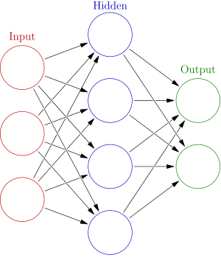
Method 1 Neural Network
Cognitive analogous model of connected neurons
Training network learns from data input
Edges between nodes weighted and updated each pass

Slide 11
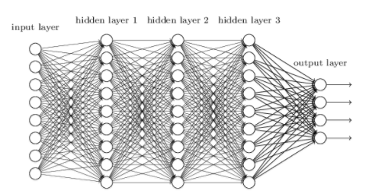
Deep (Multilayer) Neural Network

Slide 12
Results
Neural Network

Slide 13
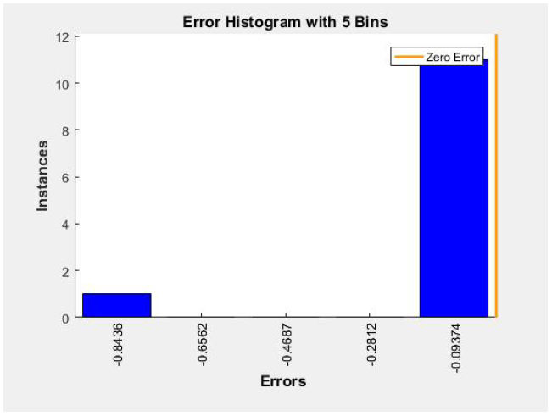
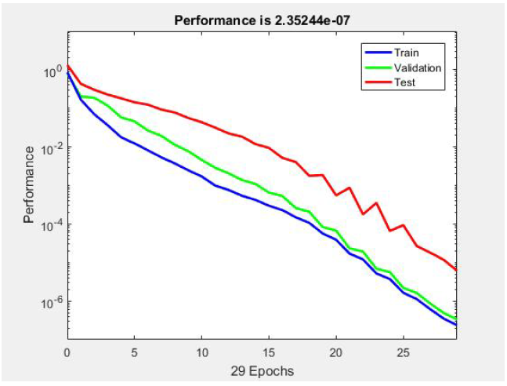
Leukemia Network Error Rate, Performance
Notes:
3

Slide 14
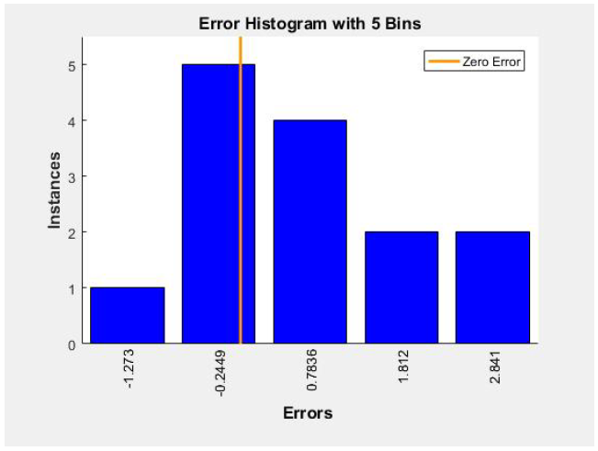
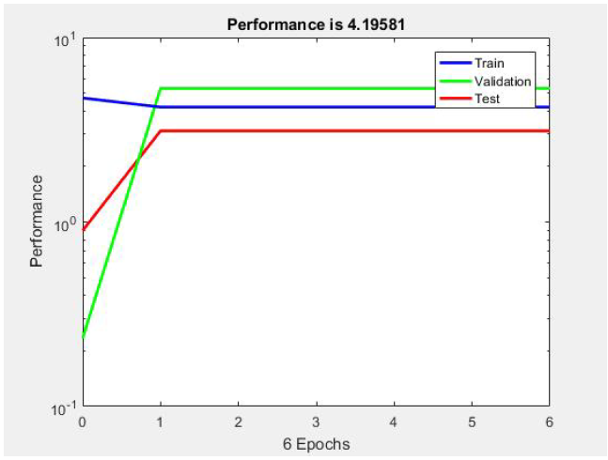
Brain Network Error Rate, Performance
Notes:
3

Slide 15
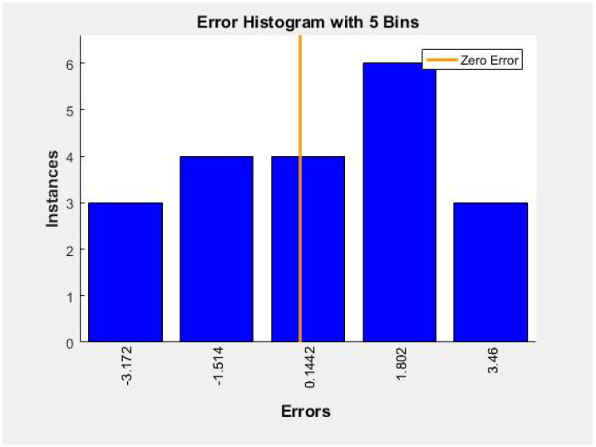
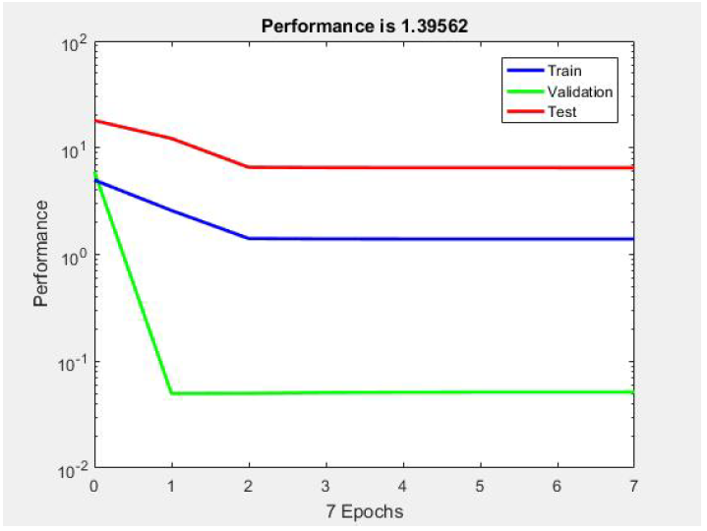
NCI 60 Network Error Rate, Performance
Notes:
3

Slide 16
Method 2
AdaBoost

Slide 17
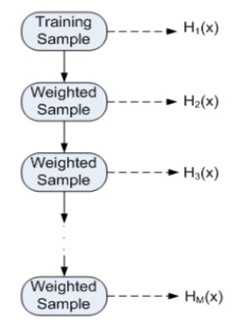
Method 2 AdaBoost
Adaptive Boosting
Strong Classifier
Reweight samples for learning
Use entire training data set
(Error = 1 - accuracy)
Notes:
AdaBoost is an ensemble boosting type classifier: Strong classifiers iteratively add on weak learners
Results in higher accuracy than weak learners alone

Slide 18
Results
AdaBoost

Slide 19
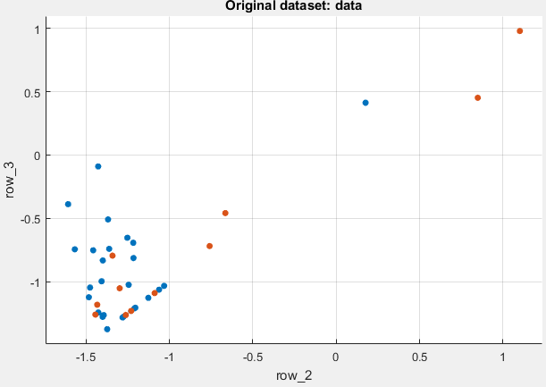
AdaBoost Default Parameters
20 maximum splits
30 learners
0.1 learning rate
Color = Class label

Slide 20
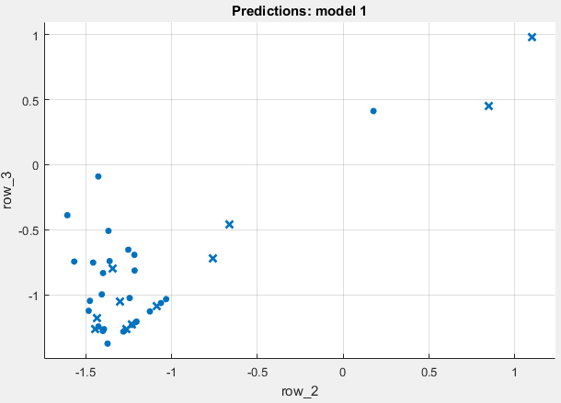

AdaBoost Error Rate, Leukaemia
Accuracy: 71.1%
Error rate: 0.289
Training time: 12.32 s
Notes:
3

Slide 21
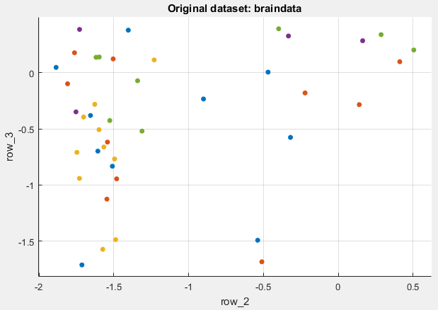
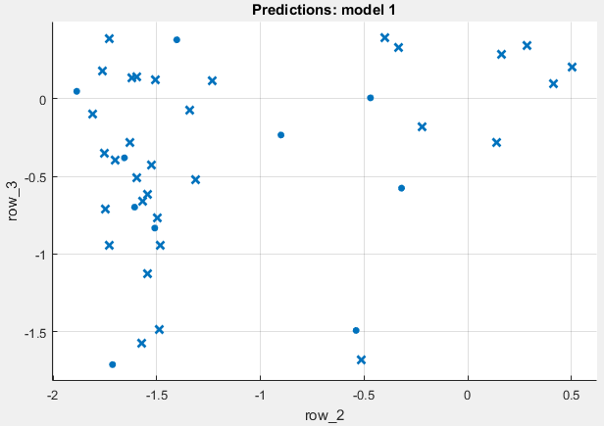
AdaBoost Brain
Accuracy: 23.8%
Error rate: 0.762
Training Time: 10.113 s

Slide 22
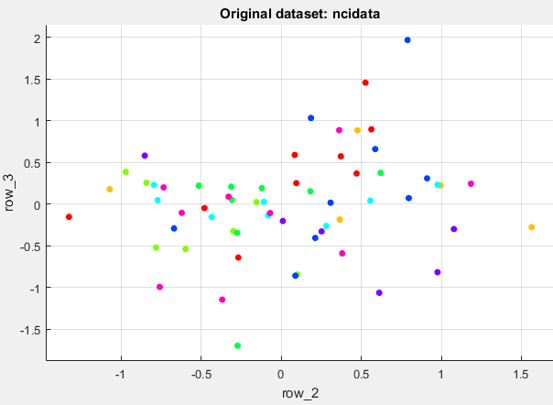
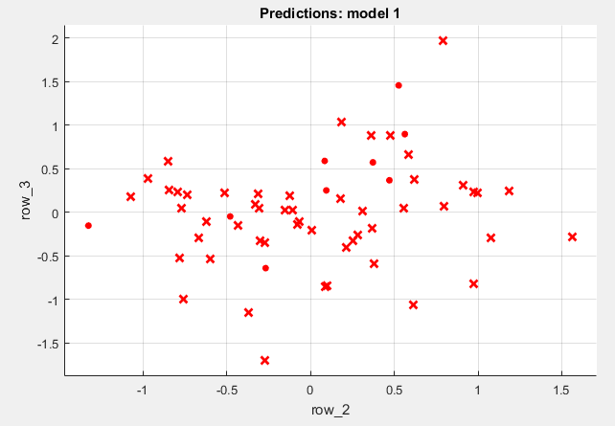
AdaBoost NCI 60
Accuracy: 14.8%
Error rate: 0.852
Training Time: 11.117 s

Slide 23
Comparative Results &
Discussion

Slide 24
Comparative Results
Error Rate | AdaBoost | Neural Network
Leukaemia | 0.289 | 0.0781
Brain | 0.762 | 0.6331
NCI 60 | 0.852 | 0.3258
Notes:
3

Slide 25
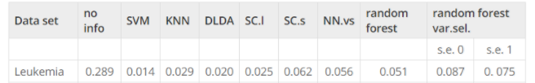
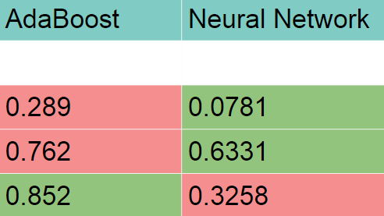
Comparative Results to Literature
AdaBoost error rate results match ‘no info’
‘no info’ refers to minimal error if no information is given from genes
(i.e., we always bet on the most frequent class)
Neural network outperforms other classifiers for <= 5 class datasets

Slide 26
Discussion
Neural network outperforms other classifiers for <= 5 class datasets
Needs further analysis isolating effect of varying number of classes
Other classifiers outperform AdaBoost consistently
Use in microarray data for gene selection is not recommended
Limitations
Small number of patients per dataset, number of classes
Leukaemia (38) two classes
Brain (42) five classes
NCI 60 (61) eight classes

Slide 27
References
Publication by Ramón Díaz-Uriarte and Sara Alvarez de Andrés, BMC Bioinformatics, 2006, 7:3
Project homepage and microarray data
Questions?

